Slide 1
EE 1520 計算機概論二 （一一三學年下學期） Introduction to Computer Science (II) Slide Set 03
S. Felix Wu
sfelixwu@gs.ncku.edu.tw
https://github.com/sfelixwu/ee1520
https://www.youtube.com/@sfelixwu
DISCORD -- TBA

Slide 2


04/15/2022

Slide 3

{
"product" :
{
"brand" : "Beck's",
"grp_id" : ”13504",
"name" : "Beck's Dark Beer - 12 Pk",
"upc14" : "00082488124003"
},
}

Slide 4

{
"from" :
{
"core" : { "owner_vsID" : "8177752121943525221986898990725294075” },
"store" : "Nugget Market”,
"vsID" : "56307055845342264413621510222129994875"
}
}

Slide 5

{
"discount" : 0.75,
"expiration" : "2020-06-36T18:34:24+0000",
"from" :
{
"core" : { "owner_vsID" : "8177752121943525221986898990725294075” },
"store" : "Nugget Market”,
"vsID" : "56307055845342264413621510222129994875"
},
"issued" : "2020-06-29T18:34:24+0000",
"message" : "beer 25% off",
"product" :
{
"brand" : "Beck's",
"grp_id" : ”13504",
"name" : "Beck's Dark Beer - 12 Pk",
"upc14" : "00082488124003"
},
"subject" : "coupon",
"to" :
{
"avatar_name" : ”Felix Wu",
"core" : { "owner_vsID" : "112638136365359060811666331781839957994” },
"vsID" : "19001943559317188636759421571670037357"
}
}

Slide 6
Objects
Description of Objects
The core issue of Object-Oriented programming!!
JSON (JavaScript Object Notation)
Representation of Objects
Standardized data interchange format

Slide 7
JSON
Linearization of an Object (C++, Python, Java)
{“key”:<value>}
{“key1”:Value1, “key2”: Value2,…}
“key” is a string, and we can re-order
{“latitude”: 38.53, “longitude”:-121.74}
{…, “home”: ????, ….}
{…, “home”: {“latitude”: 38.53, “longitude”:-121.74}, ….}

Slide 8
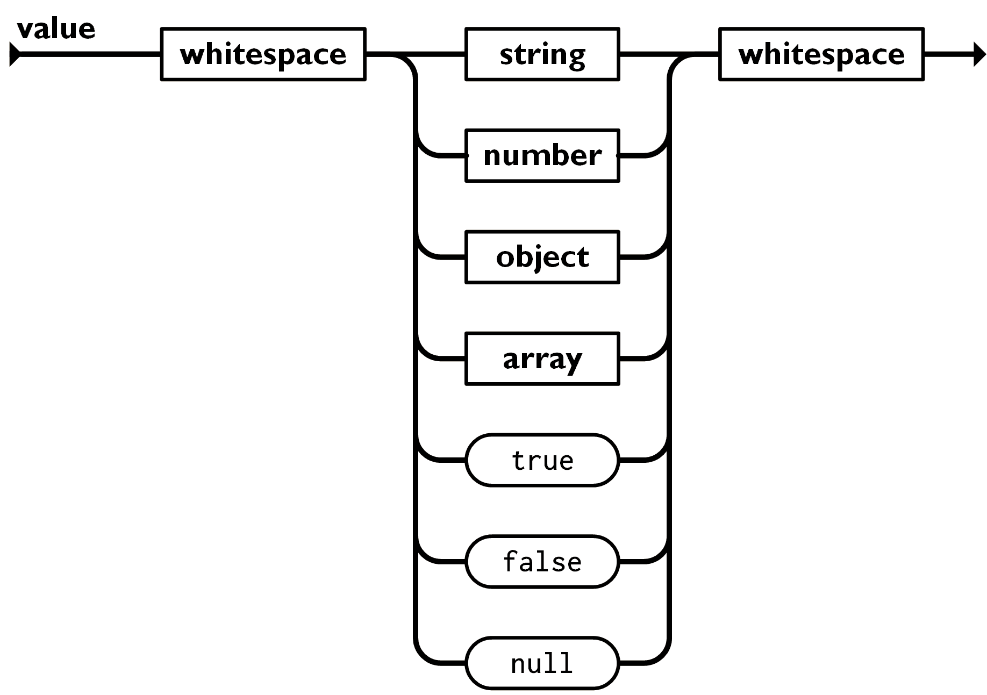
JSON Value Basic Types
Each Value could be basic data types such as string, bool, int, double, null, array, or Object
String “xyz”
Bool true, false
Int 22
Double 44.5123
Null null
Array [<value1>, <value2>, …]
Object {“key1”:<value1>, “key2”:<value2>…}

Slide 9
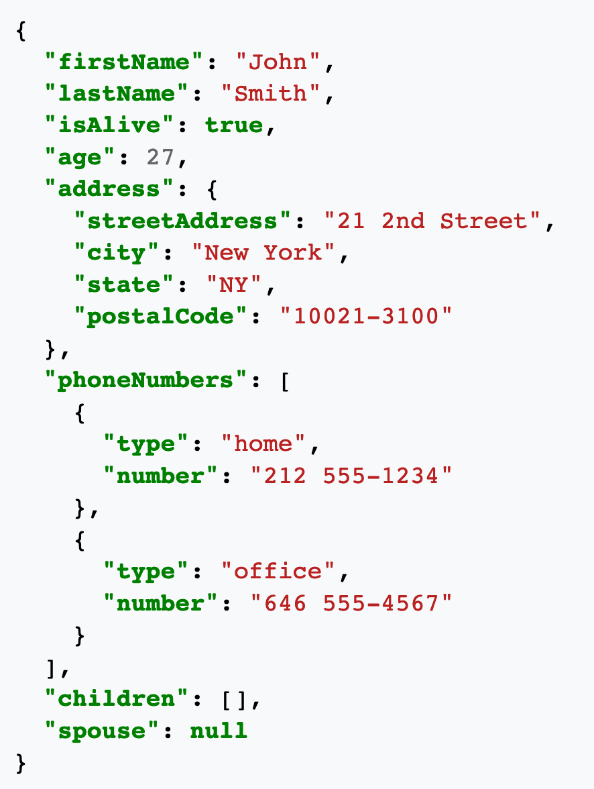
https://en.wikipedia.org/wiki/JSON

Slide 10
{
"discount" : 0.75,
"expiration" : "2020-06-36T18:34:24+0000",
"from" :
{
"core" : { "owner_vsID" : "8177752121943525221986898990725294075” },
"store" : "Nugget Market”,
"vsID" : "56307055845342264413621510222129994875"
},
"issued" : "2020-06-29T18:34:24+0000",
"message" : "beer 25% off",
"product" :
{
"brand" : "Beck's",
"grp_id" : ”13504",
"name" : "Beck's Dark Beer - 12 Pk",
"upc14" : "00082488124003"
},
"subject" : "coupon",
"to" :
{
"avatar_name" : ”Felix Wu",
"core" : { "owner_vsID" : "112638136365359060811666331781839957994” },
"vsID" : "19001943559317188636759421571670037357"
}
}

Slide 11
How many ways may I represent this picture?
04/15/2022

Slide 12
For Macbook user, you should follow this link to install JSONCPP -- https://formulae.brew.sh/formula/jsoncpp
For Ubuntu (or WSL Ubuntu), you will need to do the following –
sudo apt-get update
sudo apt-get upgrade
sudo apt-get install libjsoncpp-dev
sudo apt upgrade libjsoncpp-dev
For Ubuntu environments, you **might** also need to add -I/usr/include/jsoncpp in your Makefile to resolve “the <json/json.h> not found error”
Original Makefile CFLAGS = -g
Change to CFLAGS = -g -I/usr/include/jsoncpp

Slide 13
JSON
{“key”:[{…},{…},{…}…{…}]}
Facebook API
{“name_array”:{
{“data”:[{…},{…},{…}…{…}]},
{“count”: <size of array as int>}
}}

Slide 14
JSON ⬅ C array
{“key”:[{…},{…},{…}…{…}]}
Facebook API convention of JSON array ⬅ C++ vector
{“reactions”:{
{“data”:[{…},{…},{…}…{…}]},
{“count”: 1}
}}

Slide 15
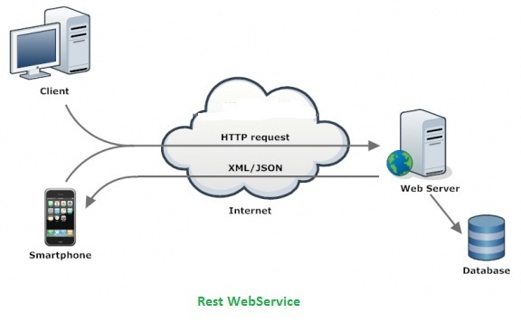
JSONs, together with XMLs, are flying on the Internet.
But, after passing the front end, only JSONs survived.
Representational State Transfer (REST)

Slide 16
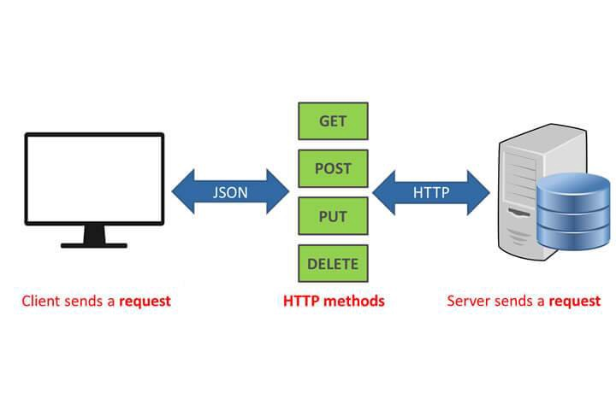

Slide 17
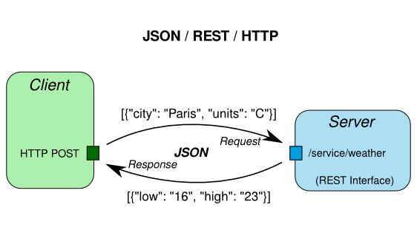

Slide 18


XML+JSON

Slide 19
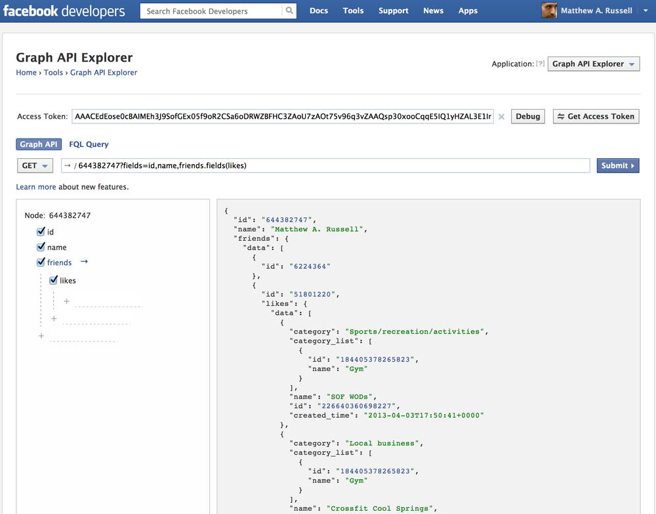

Slide 20
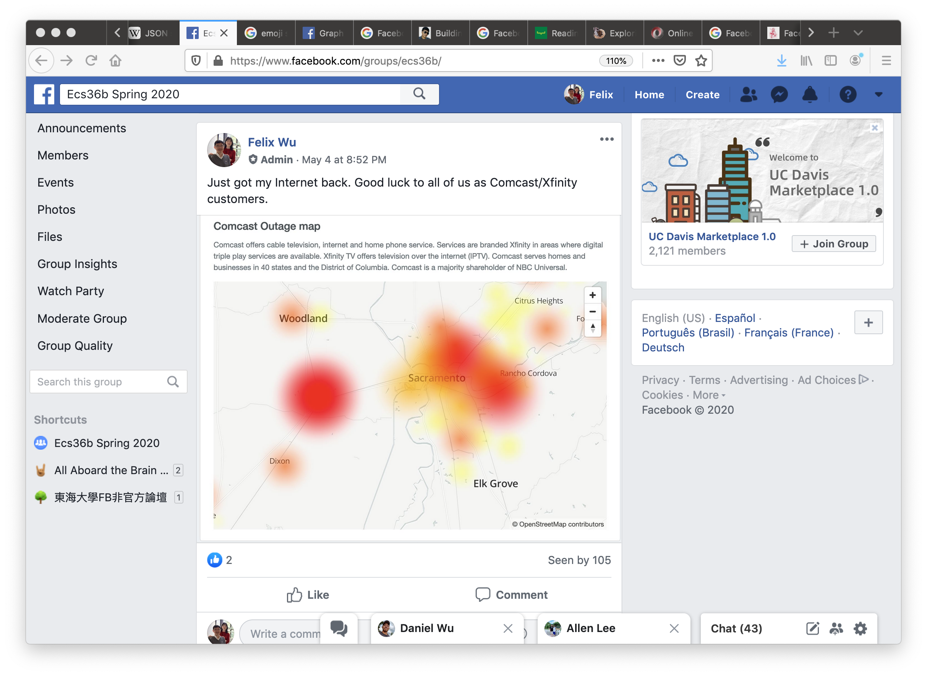

Slide 21





from Oracle (May 2, 2020, @ 4:37 pm) ➔
Just got my Internet back. Good luck to all of us as Comcast/Xfinity customers.
https://www.facebook.com/photo.php?fbid=10157251799685665
Post
Peter
from Peter (May 2, 2020, @ 4:41 pm) ➔
Professor Wu, can I get an extension even though I am an AT&T customer
Comment
Reactions
Peter
Oracle
from Oracle (May 2, 2020, @ 4:45 pm) ➔
AT&T customers got negative two days extension!
Comment
Peter
Oracle

Slide 22
{"id":"112638136365359060811666331781839957994_262650593813279","from":{"avatar_name":"Oracle","vsID":"112638136365359060811666331781839957994"},"to":{"data":[{"avatar_name":"Oracle","vsID":"112638136365359060811666331781839957994"}],"count":1},"message":"Just got my Internet back. Good luck to all of us as Comcast\/Xfinity customers.","links":{"data":[{"url":"https:\/\/www.facebook.com\/photo.php?fbid=10157251799685665","class_id":"photo","object_id":"281418948597993"}],"count":1},"actions":{"data":[{"name":"Comment","host_url":"http:\/\/localhost:8384","owner_vsID":"112638136365359060811666331781839957994","class_id":"Post","object_id":"262650593813279"},{"name":"Reaction","host_url":"http:\/\/localhost:8385","owner_vsID":"112638136365359060811666331781839957994","class_id":"Post","object_id":"262650593813279"}],"count":2},"created_time":"2020-05-02T16:37:27+0000","updated_time":"2020-05-02T16:45:18+0000","reactions":{"data":[{"avatar_name":"Peter","vsID":"1435196334234644184","type":"sad","created_time":"2020-05-02T16:37:27+0000"}],"count":1},"comments":{"data":[{"id":"112638136365359060811666331781839957994_262650593813279_262652393813099","from":{"avatar_name":"Peter","vsID":"1435196334234644184"},"message":"Professor Wu, can I get an extension even though I am an AT&T customer","created_time":"2020-05-02T16:41:17+0000","reactions":{"data":[{"avatar_name":"Peter","vsID":"1435196334234644184","type":"love","created_time":"2020-05-02T16:37:27+0000"},{"avatar_name":"Oracle","vsID":"112638136365359060811666331781839957994","type":"angry","created_time":"2020-05-02T16:39:14+0000"}],"count":2}},{"id":"112638136365359060811666331781839957994_262650593813279_262654177146254","from":{"avatar_name":"Oracle","vsID":"112638136365359060811666331781839957994"},"message":"AT&T customers got negative two days extension!","created_time":"2020-05-02T16:45:15+0000","reactions":{"data":[{"avatar_name":"Peter","vsID":"1435196334234644184","type":"sarcastic","created_time":"2020-05-02T16:45:27+0000"},{"avatar_name":"Oracle","vsID":"112638136365359060811666331781839957994","type":"happy","created_time":"2020-05-02T16:46:14+0000"}],"count":2}}],"count":2},"is_published":true}
base_input.json

Slide 23
{
"id":"112638136365359060811666331781839957994_262650593813279_262652393813099",
"from":{"avatar_name":"Peter","vsID":"1435196334234644184"},
"message":"Professor Wu, can I get an extension even though I am an AT&T customer",
"created_time":"2020-05-02T16:41:17+0000",
"reactions":{"data":[{"avatar_name":"Peter","vsID":"1435196334234644184","type":"love","created_time":"2020-05-02T16:37:27+0000"},{"avatar_name":"Oracle","vsID":"112638136365359060811666331781839957994","type":"angry","created_time":"2020-05-02T16:39:14+0000"}],"count":2}
}

Slide 24
{
"id":"112638136365359060811666331781839957994_262650593813279_262652393813099",
"from":{"avatar_name":"Peter","vsID":"1435196334234644184"},
"message":"Professor Wu, can I get an extension even though I am an AT&T customer",
"created_time":"2020-05-02T16:41:17+0000",
"reactions":{"data":[{“from”:{"avatar_name":"Peter","vsID":"1435196334234644184”},"type":"love","created_time":"2020-05-02T16:37:27+0000"},{"avatar_name":"Oracle","vsID":"112638136365359060811666331781839957994","type":"angry","created_time":"2020-05-02T16:39:14+0000"}],"count":2}
}

Slide 25
{
“from”:
{"avatar_name":"Peter","vsID":"1435196334234644184”},
"type":"love",
"created_time":"2020-05-02T16:37:27+0000”
}

Slide 26
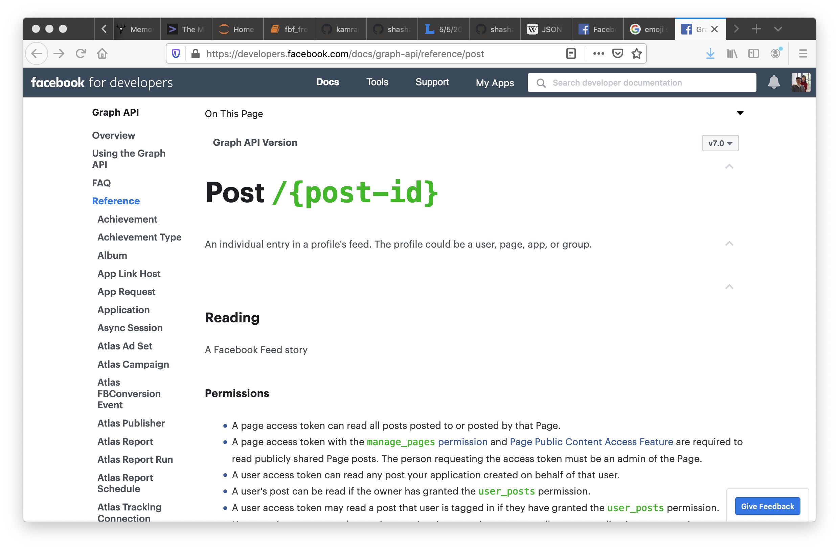
https://developers.facebook.com/docs/graph-api/reference/post

Slide 27
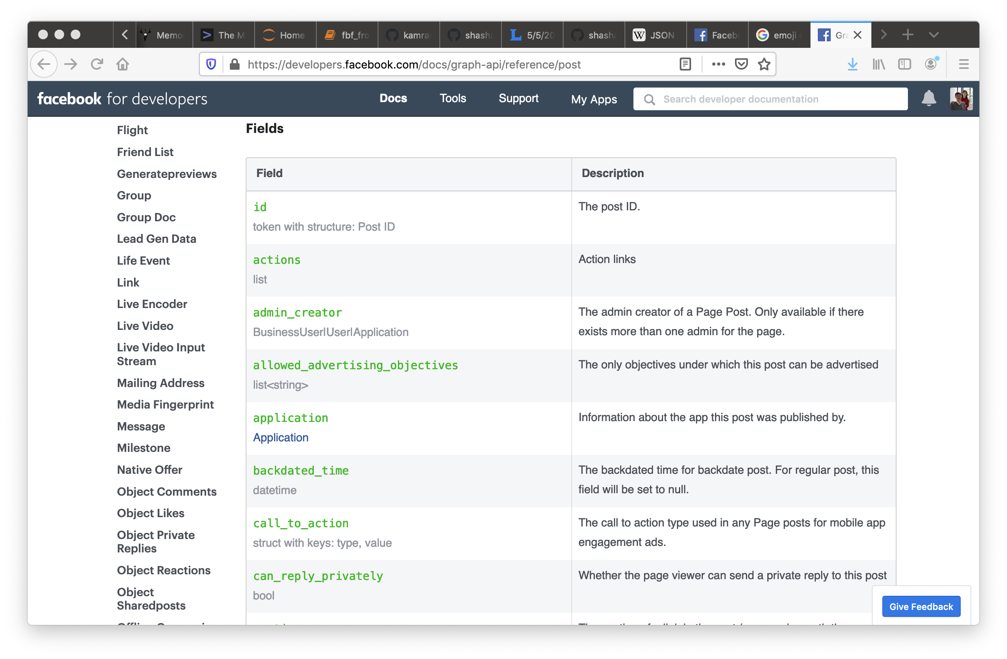

Slide 28
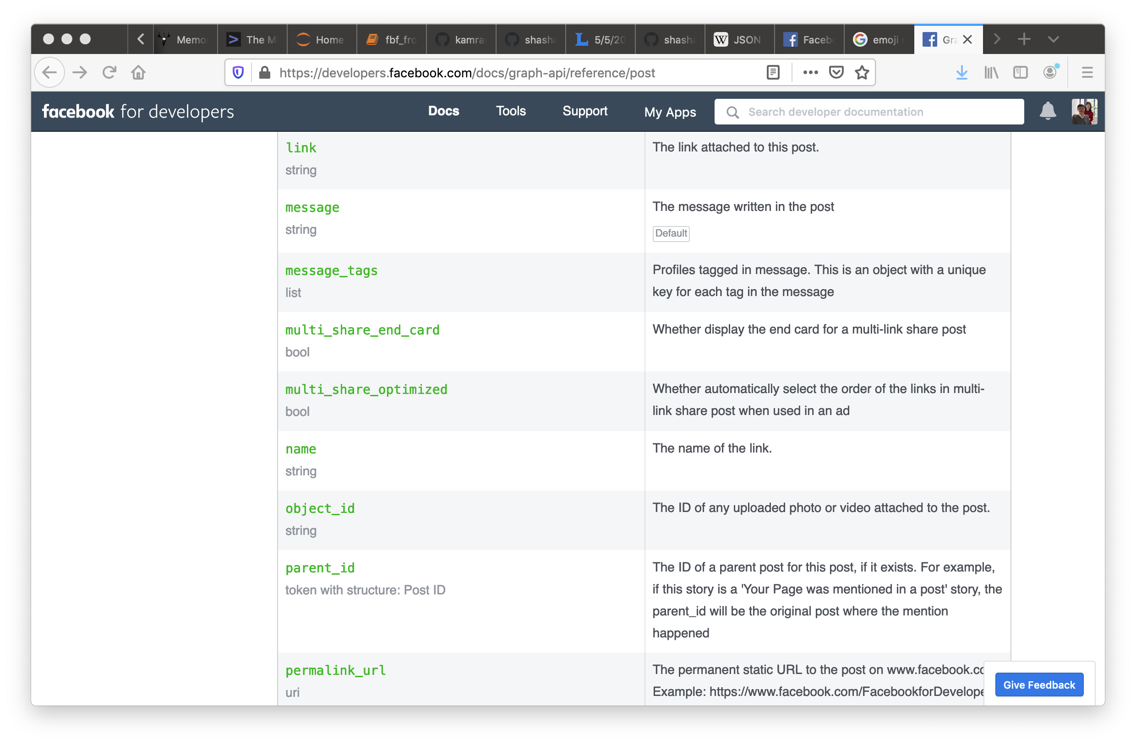

Slide 29
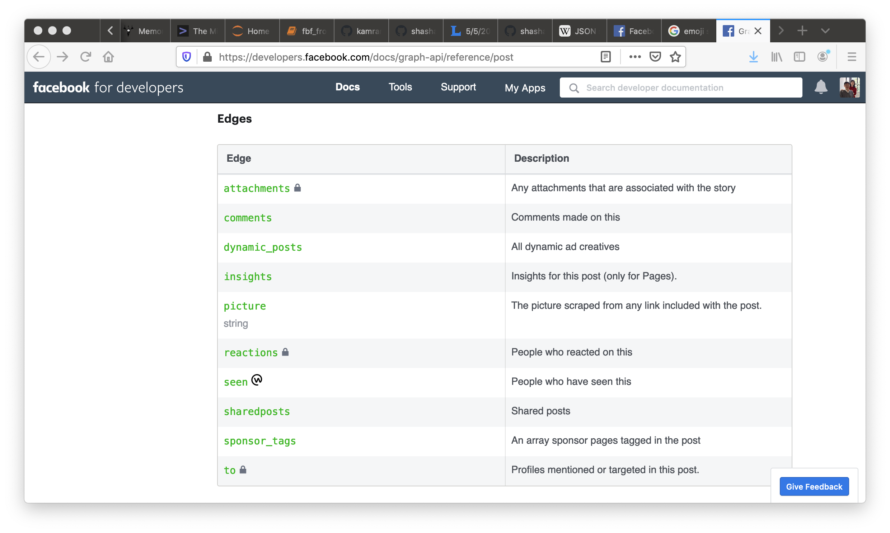

Slide 30
{
"id” : "112638136365359060811666331781839957994_262650593813279",
"from” : {
"avatar_name” : "Oracle",
"vsID” : "112638136365359060811666331781839957994”
},
"to” : {
"data” : [
{
"avatar_name” : "Oracle",
"vsID” : "112638136365359060811666331781839957994”
}
],
"count”. : 1
},
"message” : "Just got my Internet back. Good luck to all of us as Comcast/Xfinity customers.”,
"links” : {
"data” : [
{
"url” :
"https:\/\/www.facebook.com\/photo.php?fbid=10157251799685665",
"class_id” : "photo",
"object_id” : "281418948597993”
}
],
"count”. : 1
},

Slide 31
base_input.json
Core
Person
Post
JSON⬅➔C++
Message
Comment
Reaction

Slide 32
5 Steps for HW#5
Parse and Access JSON
Design and Implement C++ Classes for the base_input.json
Put parsed JSON fields, in layers, into pigeon-holes (of C++ objects)
Augment C++ Classes with dumpJ( )
Converting C++ value to Json::Value
Call dumpJ( ) to highest-level C++ object

Slide 33
We will support …
How to parse and access the JSON fields, layers, and arrays, with sample codes.
for (auto const& my_key : myv.getMemberNames()) {
std::cout << my_key << std::endl;
std::cout << myv[my_id] << std::endl;
}

Slide 34
Post
“id”:
“from”:
“created_time”:
“comments”: {
“reactions”: }
“reactions”:
…

Slide 35
Post
“id”:
“from”:
“created_time”:
“comments”: {
“reactions”: }
“reactions”:
…

Slide 36
// "reactions"
vector<Reaction *> vec_reactions;
if ((myv["reactions"]["count"]).asInt() > 0)
{
for (i = 0; i < (myv["reactions"]["count"]).asInt(); i++)
{
Json::Value l_jv = myv["reactions"]["data"][i];
Person *react_p_ptr =
new Person((l_jv["avatar_name"]).asString(),
(l_jv["vsID"]).asString());
MyTime *react_ctime_ptr = myGet_time_from_cstr
(((l_jv["created_time"]).asString()).c_str());
Reaction * react_ptr =
new Reaction(l_jv["type"].asString(),
react_p_ptr, react_ctime_ptr);
vec_reactions.push_back(react_ptr);
}
my_post.reactions = &vec_reactions;
}

Slide 37
// "reactions"
vector<Reaction *> vec_reactions;
if ((myv["reactions"]["count"]).asInt() > 0)
{
for (i = 0; i < (myv["reactions"]["count"]).asInt(); i++)
{
Json::Value l_jv = myv["reactions"]["data"][i];
Person *react_p_ptr =
new Person((l_jv["avatar_name"]).asString(),
(l_jv["vsID"]).asString());
MyTime *react_ctime_ptr = myGet_time_from_cstr
(((l_jv["created_time"]).asString()).c_str());
Reaction * react_ptr =
new Reaction(l_jv["type"].asString(),
react_p_ptr, react_ctime_ptr);
vec_reactions.push_back(react_ptr);
}
my_post.reactions = &vec_reactions;
}
http://jsoncpp.sourceforge.net/class_json_1_1_value.html

Slide 38
{"id":"112638136365359060811666331781839957994_262650593813279","from":{"avatar_name":"Oracle","vsID":"112638136365359060811666331781839957994"},"to":{"data":[{"avatar_name":"Oracle","vsID":"112638136365359060811666331781839957994"}],"count":1},"message":"Just got my Internet back. Good luck to all of us as Comcast\/Xfinity customers.","links":{"data":[{"url":"https:\/\/www.facebook.com\/photo.php?fbid=10157251799685665","class_id":"photo","object_id":"281418948597993"}],"count":1},"actions":{"data":[{"name":"Comment","host_url":"http:\/\/localhost:8384","owner_vsID":"112638136365359060811666331781839957994","class_id":"Post","object_id":"262650593813279"},{"name":"Reaction","host_url":"http:\/\/localhost:8385","owner_vsID":"112638136365359060811666331781839957994","class_id":"Post","object_id":"262650593813279"}],"count":2},"created_time":"2020-05-02T16:37:27+0000","updated_time":"2020-05-02T16:45:18+0000","reactions":{"data":[{"avatar_name":"Peter","vsID":"1435196334234644184","type":"sad","created_time":"2020-05-02T16:37:27+0000"}],"count":1},"comments":{"data":[{"id":"112638136365359060811666331781839957994_262650593813279_262652393813099","from":{"avatar_name":"Peter","vsID":"1435196334234644184"},"message":"Professor Wu, can I get an extension even though I am an AT&T customer","created_time":"2020-05-02T16:41:17+0000","reactions":{"data":[{"avatar_name":"Peter","vsID":"1435196334234644184","type":"love","created_time":"2020-05-02T16:37:27+0000"},{"avatar_name":"Oracle","vsID":"112638136365359060811666331781839957994","type":"angry","created_time":"2020-05-02T16:39:14+0000"}],"count":2}},{"id":"112638136365359060811666331781839957994_262650593813279_262654177146254","from":{"avatar_name":"Oracle","vsID":"112638136365359060811666331781839957994"},"message":"AT&T customers got negative two days extension!","created_time":"2020-05-02T16:45:15+0000","reactions":{"data":[{"avatar_name":"Peter","vsID":"1435196334234644184","type":"sarcastic","created_time":"2020-05-02T16:45:27+0000"},{"avatar_name":"Oracle","vsID":"112638136365359060811666331781839957994","type":"happy","created_time":"2020-05-02T16:46:14+0000"}],"count":2}}],"count":2},"is_published":true}
base_input.json

Slide 39
{"id":"112638136365359060811666331781839957994_262650593813279","from":{"avatar_name":"Oracle","vsID":"112638136365359060811666331781839957994"},"to":{"data":[{"avatar_name":"Oracle","vsID":"112638136365359060811666331781839957994"}],"count":1},"message":"Just got my Internet back. Good luck to all of us as Comcast\/Xfinity customers.","links":{"data":[{"url":"https:\/\/www.facebook.com\/photo.php?fbid=10157251799685665","class_id":"photo","object_id":"281418948597993"}],"count":1},"actions":{"data":[{"name":"Comment","host_url":"http:\/\/localhost:8384","owner_vsID":"112638136365359060811666331781839957994","class_id":"Post","object_id":"262650593813279"},{"name":"Reaction","host_url":"http:\/\/localhost:8385","owner_vsID":"112638136365359060811666331781839957994","class_id":"Post","object_id":"262650593813279"}],"count":2},"created_time":"2020-05-02T16:37:27+0000","updated_time":"2020-05-02T16:45:18+0000","reactions":{"data":[{"avatar_name":"Peter","vsID":"1435196334234644184","type":"sad","created_time":"2020-05-02T16:37:27+0000"}],"count":1},"comments":{"data":[{"id":"112638136365359060811666331781839957994_262650593813279_262652393813099","from":{"avatar_name":"Peter","vsID":"1435196334234644184"},"message":"Professor Wu, can I get an extension even though I am an AT&T customer","created_time":"2020-05-02T16:41:17+0000","reactions":{"data":[{"avatar_name":"Peter","vsID":"1435196334234644184","type":"love","created_time":"2020-05-02T16:37:27+0000"},{"avatar_name":"Oracle","vsID":"112638136365359060811666331781839957994","type":"angry","created_time":"2020-05-02T16:39:14+0000"}],"count":2}},{"id":"112638136365359060811666331781839957994_262650593813279_262654177146254","from":{"avatar_name":"Oracle","vsID":"112638136365359060811666331781839957994"},"message":"AT&T customers got negative two days extension!","created_time":"2020-05-02T16:45:15+0000","reactions":{"data":[{"avatar_name":"Peter","vsID":"1435196334234644184","type":"sarcastic","created_time":"2020-05-02T16:45:27+0000"},{"avatar_name":"Oracle","vsID":"112638136365359060811666331781839957994","type":"happy","created_time":"2020-05-02T16:46:14+0000"}],"count":2}}],"count":2},"is_published":true}
base_input.json

Slide 40
"reactions":{"data":[{"avatar_name":"Peter","vsID":"1435196334234644184",
"type":"sad","created_time":"2020-05-02T16:37:27+0000"}],"count":1}

Slide 41
"reactions":{"data":[{"avatar_name":"Peter","vsID":"1435196334234644184",
"type":"sad","created_time":"2020-05-02T16:37:27+0000"}],"count":1}
"reactions":{"data":[{"avatar_name":"Peter","vsID":"1435196334234644184",
"type":"sad","created_time":"2020-05-02T16:37:27+0000"}],"count":1}

Slide 42
"reactions":{"data":[{"avatar_name":"Peter","vsID":"1435196334234644184",
"type":"sad","created_time":"2020-05-02T16:37:27+0000"}],"count":1}
"reactions":{"data":[{"avatar_name":"Peter","vsID":"1435196334234644184",
"type":"sad","created_time":"2020-05-02T16:37:27+0000"}],"count":1}
"reactions":{"data":[{"avatar_name":"Peter","vsID":"1435196334234644184",
"type":"sad","created_time":"2020-05-02T16:37:27+0000"}],"count":1}

Slide 43
"reactions":{"data":[{"avatar_name":"Peter","vsID":"1435196334234644184",
"type":"sad","created_time":"2020-05-02T16:37:27+0000"}],"count":1}
"reactions":{"data":[{"avatar_name":"Peter","vsID":"1435196334234644184",
"type":"sad","created_time":"2020-05-02T16:37:27+0000"}],"count":1}
"reactions":{"data":[{"avatar_name":"Peter","vsID":"1435196334234644184",
"type":"sad","created_time":"2020-05-02T16:37:27+0000"}],"count":1}
if ((myv["reactions"]["count"]).asInt() > 0)
How do you tell whether the first reaction of the array was happy or sad?

Slide 44
if (((myv["reactions"]["count"]).asInt() > 0)) &&
(myv["reactions"][”data”]).isArray() == TRUE
(myv["reactions"][”data”][0]))
(myv["reactions"][”data”][0])).isObject() ==TRUE
(myv["reactions"][”data”][0][“type”]))
(myv["reactions"][”data”][0][“type”]).isString() == TRUE
(myv["reactions"][”data”][0][“type”]).asString() == “happy”
{
}

Slide 45
// "reactions"
vector<Reaction *> vec_reactions;
if ((myv["reactions"]["count"]).asInt() > 0)
{
for (i = 0; i < (myv["reactions"]["count"]).asInt(); i++)
{
Json::Value l_jv = myv["reactions"]["data"][i];
Person *react_p_ptr =
new Person((l_jv["avatar_name"]).asString(),
(l_jv["vsID"]).asString());
MyTime *react_ctime_ptr = myGet_time_from_cstr
(((l_jv["created_time"]).asString()).c_str());
Reaction * react_ptr =
new Reaction(l_jv["type"].asString(),
react_p_ptr, react_ctime_ptr);
vec_reactions.push_back(react_ptr);
}
my_post.reactions = &vec_reactions;
}

Slide 46
"reactions":{"data":[{"avatar_name":"Peter","vsID":"1435196334234644184",
"type":"sad","created_time":"2020-05-02T16:37:27+0000"}],"count":1}
"reactions":{"data":[{"avatar_name":"Peter","vsID":"1435196334234644184",
"type":"sad","created_time":"2020-05-02T16:37:27+0000"}],"count":1}
"reactions":{"data":[{"avatar_name":"Peter","vsID":"1435196334234644184",
"type":"sad","created_time":"2020-05-02T16:37:27+0000"}],"count":1}
"reactions":{"data":[{"avatar_name":"Peter","vsID":"1435196334234644184",
"type":"sad","created_time":"2020-05-02T16:37:27+0000"}],"count":1}
Json::Value l_jv = myv["reactions"]["data"][i];

Slide 47
Json::Value json_reactions;
Json::Value json_reactions_array;
"reactions":{"data":[{"avatar_name":"Peter","vsID":"1435196334234644184",
"type":"sad","created_time":"2020-05-02T16:37:27+0000"}],"count":1}
"reactions":{"data":[{"avatar_name":"Peter","vsID":"1435196334234644184",
"type":"sad","created_time":"2020-05-02T16:37:27+0000"}],"count":1}
Data ➔ array
Count ➔ size

Slide 48
"reactions":{"data":[{"avatar_name":"Peter","vsID":"1435196334234644184",
"type":"sad","created_time":"2020-05-02T16:37:27+0000"}],"count":1}
"reactions":{"data":[{"avatar_name":"Peter","vsID":"1435196334234644184",
"type":"sad","created_time":"2020-05-02T16:37:27+0000"}],"count":1}
"reactions":{"data":[{"avatar_name":"Peter","vsID":"1435196334234644184",
"type":"sad","created_time":"2020-05-02T16:37:27+0000"}],"count":1}
"reactions":{"data":[{"avatar_name":"Peter","vsID":"1435196334234644184",
"type":"sad","created_time":"2020-05-02T16:37:27+0000"}],"count":1}
Json::Value l_jv = myv["reactions"]["data"][0];
Json::Value l_jv = myv["reactions"]["data"][i];

Slide 49
// "reactions"
vector<Reaction *> vec_reactions;
if ((myv["reactions"]["count"]).asInt() > 0)
{
for (i = 0; i < (myv["reactions"]["count"]).asInt(); i++)
{
Json::Value l_jv = myv["reactions"]["data"][i];
Person *react_p_ptr =
new Person((l_jv["avatar_name"]).asString(),
(l_jv["vsID"]).asString());
MyTime *react_ctime_ptr = myGet_time_from_cstr
(((l_jv["created_time"]).asString()).c_str());
Reaction * react_ptr =
new Reaction(l_jv["type"].asString(),
react_p_ptr, react_ctime_ptr);
vec_reactions.push_back(react_ptr);
}
my_post.reactions = &vec_reactions;
}

Slide 50
(l_jv["avatar_name"]).asString()
(myv["reactions"]["data"][i]["avatar_name"]).asString()
(l_jv["avatar_name"]).asString()
(myv["reactions"]["data"][i]["avatar_name"]).asString()
Indent
Understand reference implementation
Understand JSON C++ programming
Seg-fault or any kind of problem ➔ first step is locate the bug

Slide 51
// "reactions"
vector<Reaction *> vec_reactions;
if ((myv["reactions"]["count"]).asInt() > 0)
{
for (i = 0; i < (myv["reactions"]["count"]).asInt(); i++)
{
Json::Value l_jv = myv["reactions"]["data"][i];
Person *react_p_ptr =
new Person((l_jv["avatar_name"]).asString(),
(l_jv["vsID"]).asString());
MyTime *react_ctime_ptr = myGet_time_from_cstr
(((l_jv["created_time"]).asString()).c_str());
Reaction * react_ptr =
new Reaction(l_jv["type"].asString(),
react_p_ptr, react_ctime_ptr);
vec_reactions.push_back(react_ptr);
}
my_post.reactions = &vec_reactions;
}

Slide 52
// "reactions"
vector<Reaction *> vec_reactions;
if ((myv["reactions"]["count"]).asInt() > 0)
{
for (i = 0; i < (myv["reactions"]["count"]).asInt(); i++)
{
Json::Value l_jv = myv["reactions"]["data"][i];
Person *react_p_ptr =
new Person((l_jv["avatar_name"]).asString(),
(l_jv["vsID"]).asString());
MyTime *react_ctime_ptr = myGet_time_from_cstr
(((l_jv["created_time"]).asString()).c_str());
Reaction * react_ptr =
new Reaction(l_jv["type"].asString(),
react_p_ptr, react_ctime_ptr);
vec_reactions.push_back(react_ptr);
}
my_post.reactions = &vec_reactions;
}

Slide 53
// "reactions"
vector<Reaction *> vec_reactions;
if ((myv["reactions"]["count"]).asInt() > 0)
{
for (i = 0; i < (myv["reactions"]["count"]).asInt(); i++)
{
Json::Value l_jv = myv["reactions"]["data"][i];
Person *react_p_ptr =
new Person((l_jv["avatar_name"]).asString(),
(l_jv["vsID"]).asString());
MyTime *react_ctime_ptr = myGet_time_from_cstr
(((l_jv["created_time"]).asString()).c_str());
Reaction * react_ptr =
new Reaction(l_jv["type"].asString(),
react_p_ptr, react_ctime_ptr);
vec_reactions.push_back(react_ptr);
}
my_post.reactions = &vec_reactions;
}

Slide 54
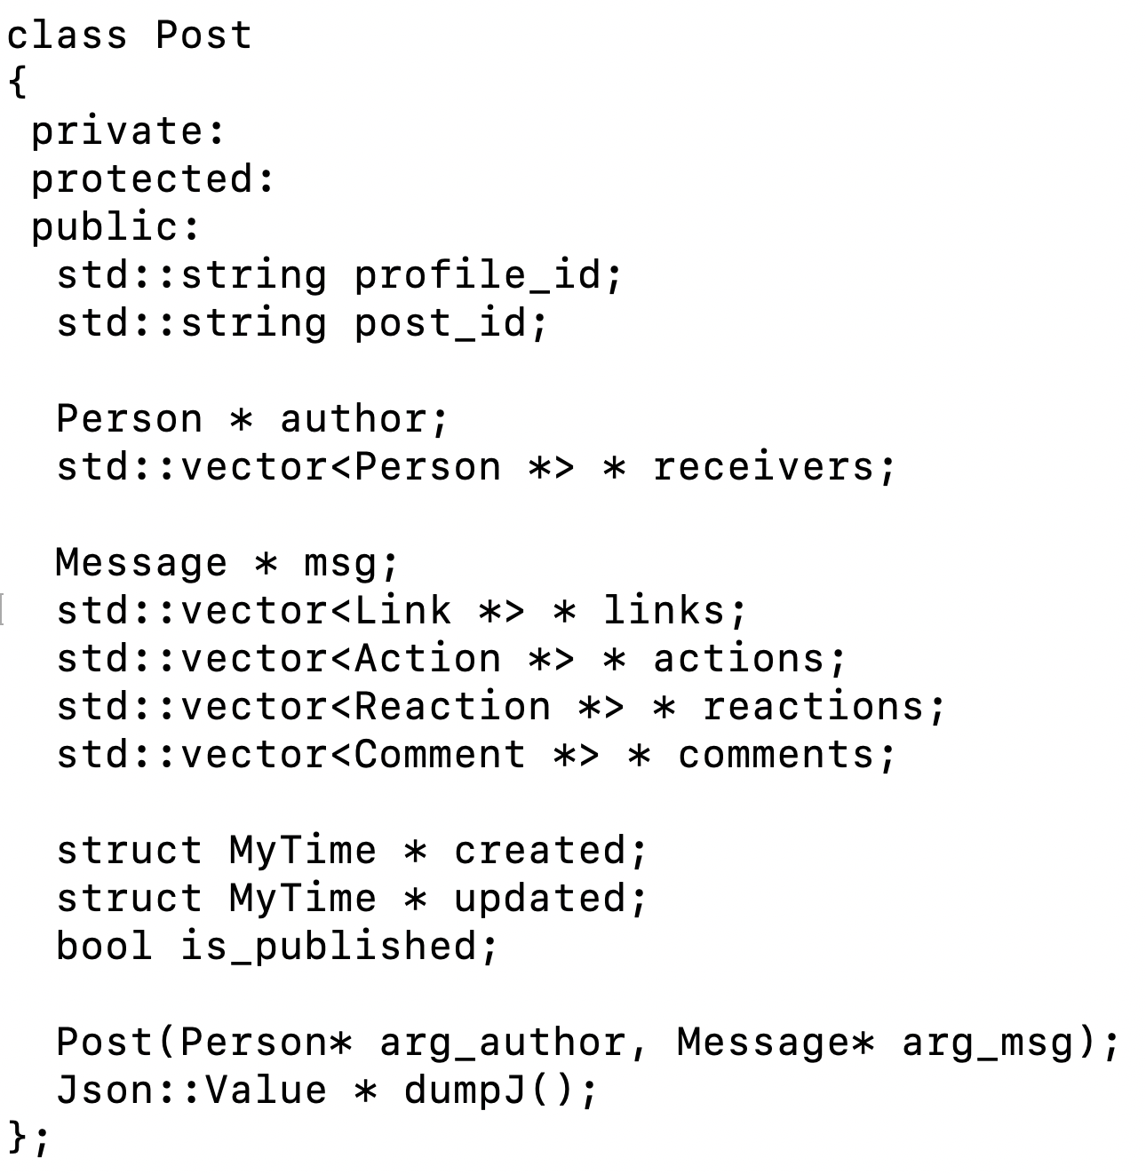

Slide 56
dumpJ()
Get the Json::Value representation from the C++ objects
Core
Persistent Objects
Transient Objects
Person
Post
base_input.json
JSON⬅➔C++
Message
Comment
Reaction

Slide 57
Json::Value * Reaction::dumpJ
(void)
{
Json::Value * result_ptr = (this->author)->dumpJ();
(*result_ptr)["type"] = this->type;
(*result_ptr)["created_time"] = *(myGet_time_dumpStr(this->created));
#ifdef _ECS36B_DEBUG_
std::cout << result_ptr->toStyledString() << std::endl;
#endif /* _ECS36B_DEBUG_ */
return result_ptr;
}

Slide 58
Json::Value * Reaction::dumpJ
(void)
{
Json::Value * result_ptr = (this->author)->dumpJ();
(*result_ptr)["type"] = this->type;
(*result_ptr)["created_time"] = *(myGet_time_dumpStr(this->created));
#ifdef _ECS36B_DEBUG_
std::cout << result_ptr->toStyledString() << std::endl;
#endif /* _ECS36B_DEBUG_ */
return result_ptr;
}

Slide 59
Json::Value * Person::dumpJ
(void)
{
Json::Value *result_ptr = new Json::Value();
(*result_ptr)["avatar_name"] = this->avatar_name;
(*result_ptr)["vsID"] = this->vsID;
#ifdef _ECS36B_DEBUG_
std::cout << result_ptr->toStyledString() << std::endl;
#endif /* _ECS36B_DEBUG_ */
return result_ptr;
}
Json::Value * Reaction::dumpJ
(void)
{
Json::Value * result_ptr = (this->author)->dumpJ();
(*result_ptr)["type"] = this->type;
(*result_ptr)["created_time"] = *(myGet_time_dumpStr(this->created));
#ifdef _ECS36B_DEBUG_
std::cout << result_ptr->toStyledString() << std::endl;
#endif /* _ECS36B_DEBUG_ */
return result_ptr;
}

Slide 60
Json::Value * Person::dumpJ
(void)
{
Json::Value *result_ptr = new Json::Value();
(*result_ptr)["avatar_name"] = this->avatar_name;
(*result_ptr)["vsID"] = this->vsID;
#ifdef _ECS36B_DEBUG_
std::cout << result_ptr->toStyledString() << std::endl;
#endif /* _ECS36B_DEBUG_ */
return result_ptr;
}
{"avatar_name":"Peter","vsID":"1435196334234644184"}
Json::Value * Reaction::dumpJ
(void)
{
Json::Value * result_ptr = (this->author)->dumpJ();
(*result_ptr)["type"] = this->type;
(*result_ptr)["created_time"] = *(myGet_time_dumpStr(this->created));
#ifdef _ECS36B_DEBUG_
std::cout << result_ptr->toStyledString() << std::endl;
#endif /* _ECS36B_DEBUG_ */
return result_ptr;
}
{"avatar_name":"Peter","vsID":"1435196334234644184","type":"sad","created_time":"2020-05-02T16:37:27+0000"}

Slide 61
5 Steps for HW#5
Parse and Access JSON
Design and Implement C++ Classes for the base_input.json
Put parsed JSON fields, in layers, into pigeon-holes (of C++ objects)
Augment C++ Classes with dumpJ( )
Converting C++ value to Json::Value
Call dumpJ( ) to highest-level C++ object

Slide 62
std::vector<Reaction *> * reactions;
reactions ➔ variable
reactions’s type ➔ pointer to a vector of pointers
comment_obj->reactions
R
R
Vector (1st)
0
1
2
3
pushback
R
R

Slide 63
std::vector<Reaction *> * reactions;
reactions ➔ variable
reactions’s type ➔ pointer to a vector of pointers
comment_obj->reactions
R
R
Vector (1st)
0
1
2
3
pushback
R
R
mypost
Pointer to a Vector <Action *>
(*(mypost_ptr->actions)).pushback(action_ptr);
actions

Slide 64
my_post.created = new JvTime(((myv_message["created_time"]).asString()).c_str());
Pointer to <Class_Type> = new
<Class_Type>(argument(s) to constructor for <Class_type>);
“Heap” malloc/free new/delete
<Class_Type> objX { … };
Scoping
Account *x_ptr;
for(;;)
{
Account x; // stack
x_ptr = &x;
}
*x_ptr

Slide 65
// "reactions” under comments
vector<Reaction *> * vec_reactions_ptr;
for (j = 0; j < (l_jv["reactions"]["count"]).asInt(); j++)
{
Json::Value l_jv_cr = l_jv["reactions"]["data"][i];
Person *react_p_ptr =
new Person((l_jv_cr["avatar_name"]).asString(),
(l_jv_cr["vsID"]).asString());
MyTime *react_ctime_ptr = myGet_time_from_cstr
(((l_jv["created_time"]).asString()).c_str());
Reaction * react_ptr =
new Reaction(l_jv["type"].asString(),
react_p_ptr, react_ctime_ptr);
vec_reactions_ptr->push_back(react_ptr);
}
comment_ptr->reactions = vec_reactions_ptr;

Slide 66
JSON Array
[“abc”, “cde”, “eee”]
[<person1>, <person2>, <person3>]
[<person1>, <phone>, <laptop>,<tax record>]

